Slide 1



News Feed Website
Group Members:
Kerllos Gerges
Ekubay berhne
Zayed Hassan

Slide 2



Tasks
Module / Tasks | Status |  | Technologies and tools
Front End
Master page layout | done | Kerllos | Bootstrap css framework jQuery frame work Ajax Servlet JSP JSTL HTML5 Intellij IDE
Dynamic menu | done | Zayed
Article page | done | Kerllos
Dynamic latest news bar | done | Zayed
Dynamic latest posts section | done | Zayed
Contact US page | done | Ekubay
Back end
Master page layout | done | Kerllos
Master page menu | done | Kerllos
Article categories CRUD operation | done | Kerllos
Article CRUD operation | done | Kerllos
Contact US display | done | Ekubay
Login | done | Zayed,Kerllos
DB design
Category Table | done | Kerllos | Mysql workbench SQL
Article Table | done | Kerllos
Contact us | done | Ekubay
user | done | Zayed

Slide 3
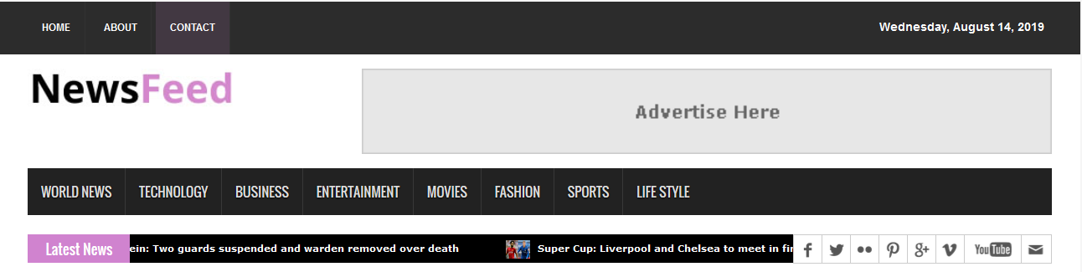
Home Page

Slide 4
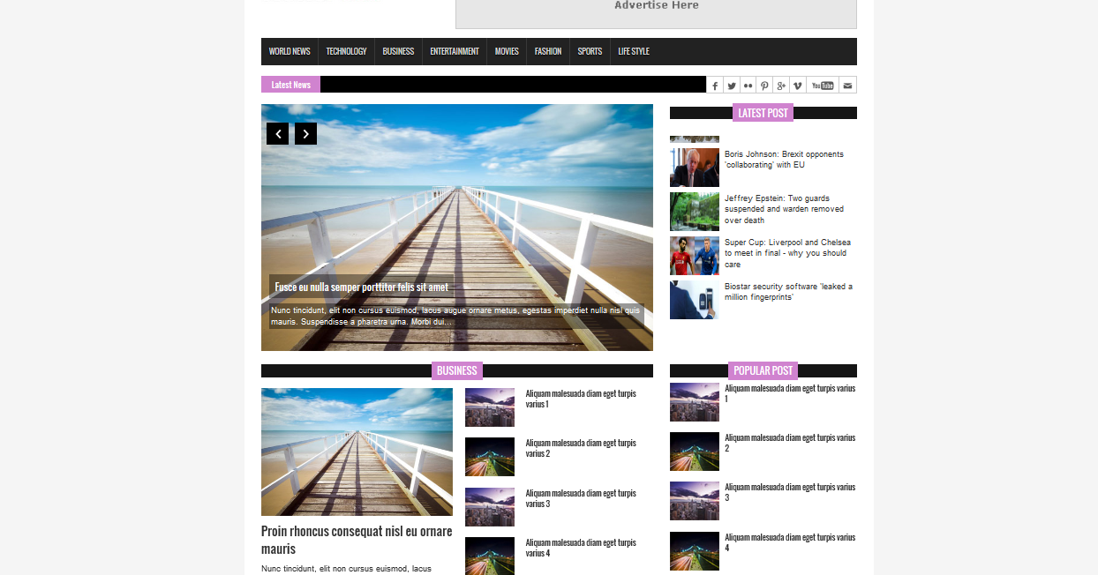

Slide 5
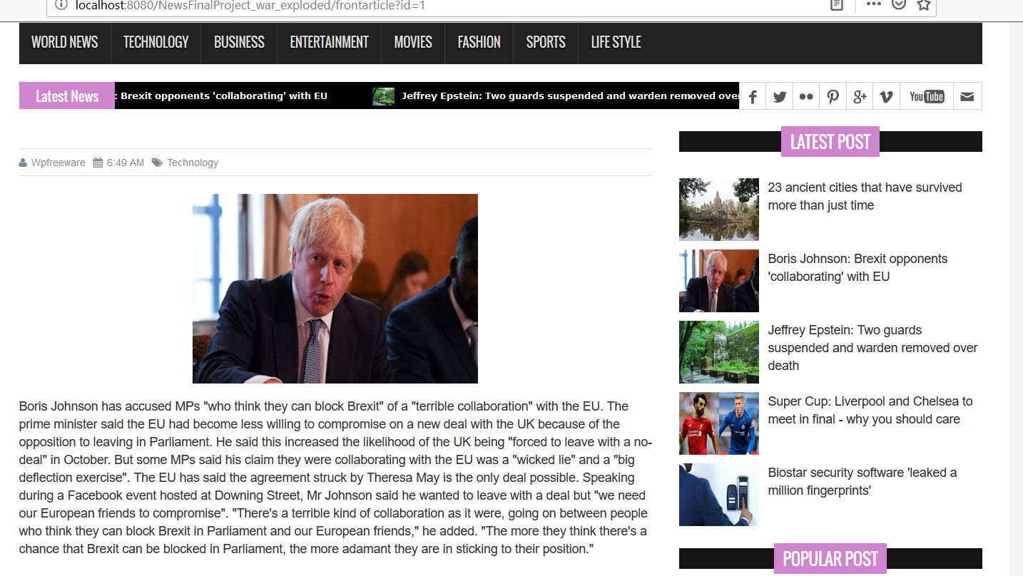

Slide 6
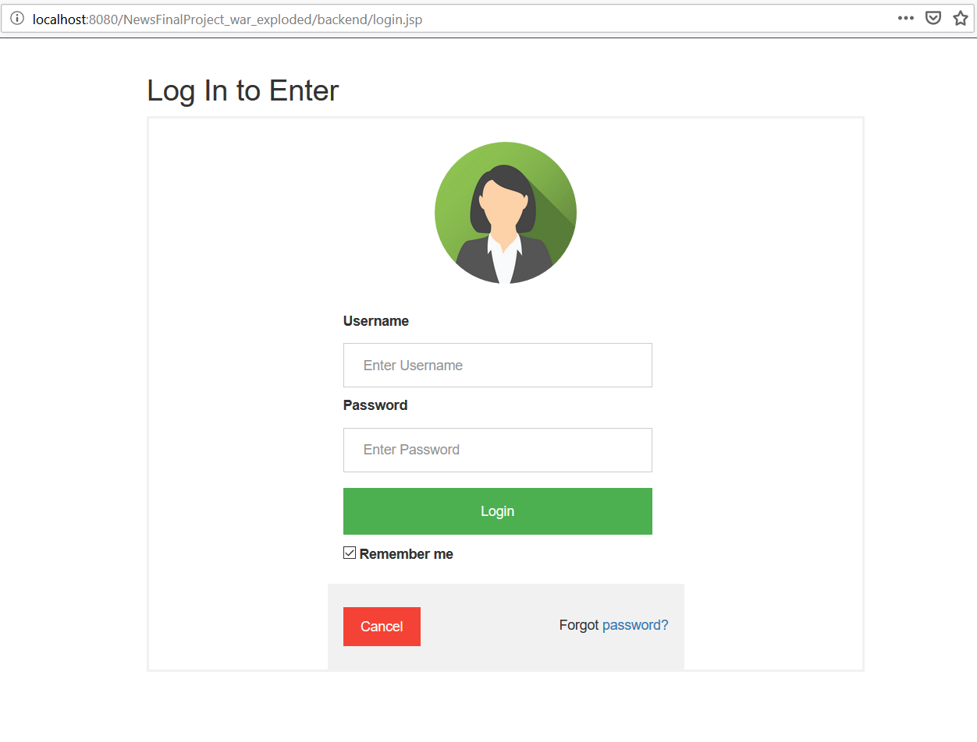

Slide 7
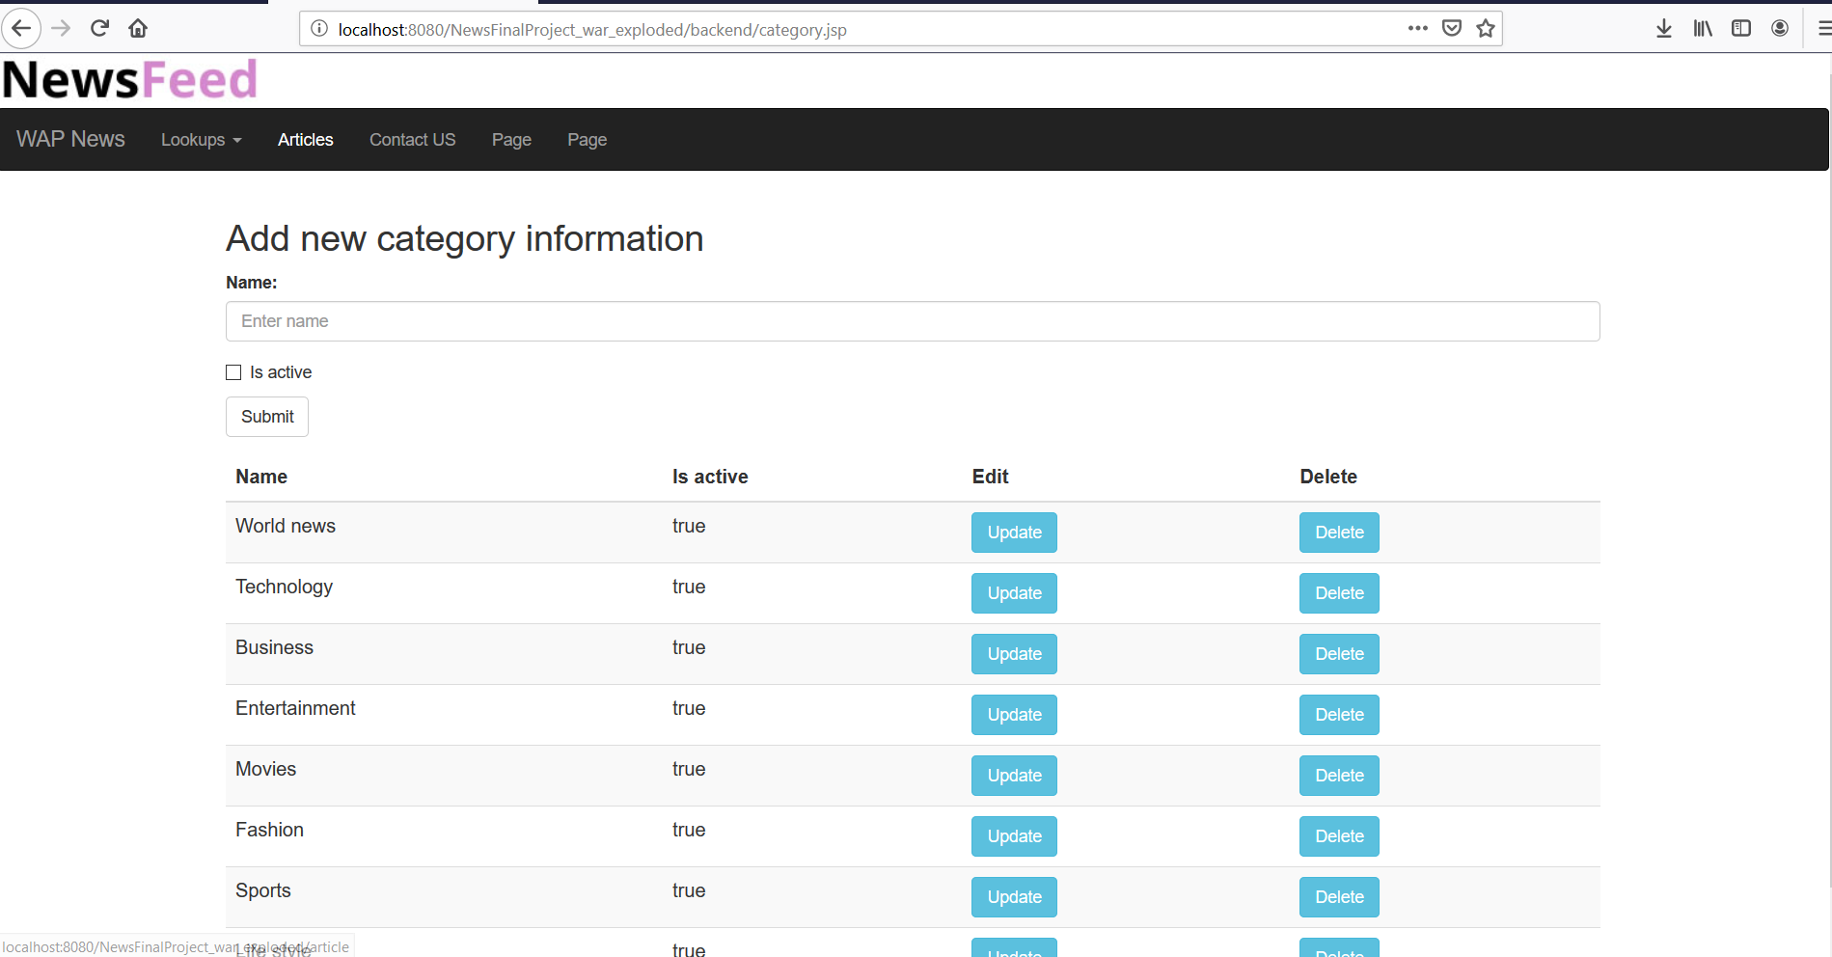

Slide 8
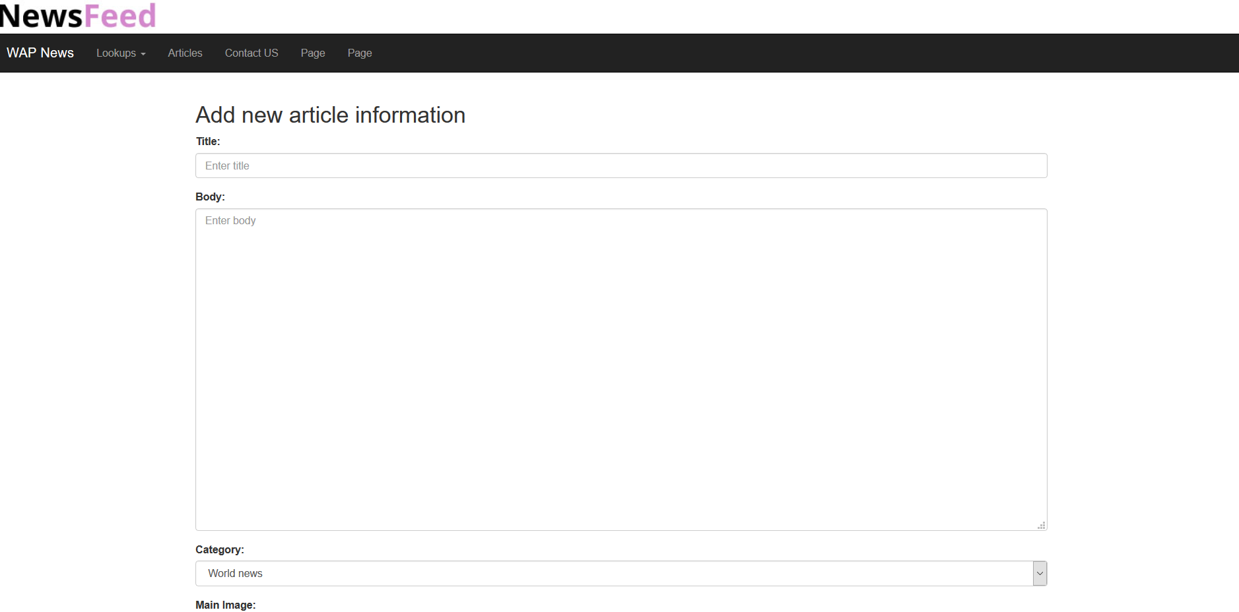

Slide 9
